Slide 1
Autonomic Regulation Therapy for the Improvement of Left Ventricular Function and Heart Failure Symptoms: The ANTHEM-HF Study
Rajendra K. Premchand, Kamal Sharma, Sanjay Mittal,
Rufino Monteiro, Imad Libbus, Lorenzo DiCarlo,
Jeffrey L. Ardell, Thomas S. Rector, Badri Amurthur,
Bruce H. KenKnight, Inder S. Anand
for the ANTHEM-HF Investigators

Slide 2
Disclosures
This study was sponsored by Cyberonics, Houston, USA
Inder Anand has consulted for and/or received research support from Amgen, Critical Diagnostics, Cyberonics, Novartis, Zensun

Slide 3
Background
Autonomic imbalance in HF is characterized by increased sympathetic activity and withdrawal of parasympathetic activity
Autonomic imbalance is associated with progression of HF and worse outcomes
Pre-clinical & clinical studies suggest electrical stimulation of the vagus nerve may restore autonomic balance
Left-sided VNS, which could be combined with devices, has not been evaluated in HF patients, and the effects of left and right VNS have not been directly compared

Slide 4
Objectives
Evaluate a new autonomic regulation therapy (ART) with left or right VNS, for the treatment of chronic symptomatic heart failure with reduced ejection fraction
Feasibility and Tolerability of the ART system
Primary safety endpoint: Incidence of procedure and device-related adverse events during the 9-month duration of the study
Primary efficacy endpoint: Changes in left ventricular ejection fraction (LVEF) and end-systolic volume (LVESV) at 6 months

Slide 5
Secondary Endpoints
Changes at 6 months in:
Left ventricular end-systolic diameter (LVESD)
6-minute walk distance
Quality of life (Minnesota Living with HF Questionnaire)
NYHA Class
Heart rate variability (HRV)
Blood biomarkers (NT-proBNP and hs-CRP)

Slide 6
ANTHEM-HF Committees
Steering Committee
Inder Anand, MD, FACC (Chair)
Jeffrey Ardell, PhD
Lorenzo DiCarlo, MD, FACC
Sanjay Mittal, MD
Badri Amurthur, MS
Imad Libbus, PhD
Bruce KenKnight, PhD
Independent Data & Safety Monitoring Board
Gary Francis, MD, FACC (Chair)
Thomas Rector, PhD
Independent Statistical Analysis
Thomas Rector, PhD
Independent Clinical Events Committee
Lorenzo DiCarlo, MD, FACC (Chair)
David Cannom, MD, FACC
Echocardiographic Core Laboratory
Care Hospital, Hyderabad, India
Blood and Biomarker Core Laboratory
Metropolis Healthcare, Mumbai, India
Sponsor
Cyberonics, Inc., Houston, USA

Slide 7
Clinical Study Sites
Clinical Site |  | Principal Investigator
 | Medanta, New Delhi | Dr. Naresh Trehan Dr. Sanjay Mittal
 | Sanjivani, Ahmedabad | Dr. Kamal Sharma Dr. Satyajit Dixit
 | Narayana Hrudayala, Bangalore | Dr. Ravi Kishore
 | Madras Medical Mission, Chennai | Dr. Ulhas Pandurangi Dr. Ajit
 | KIMS, Hyderabad | Dr. Rajendra Kumar
 | Yashoda Hospital, Hyderabad | Dr. Rajasekhar
 | Sengupta Hospital, Nagpur | Dr. Sengupta
 | DMH Hospital, Pune | Dr. Sathe
 | Vintage Hospital, Goa | Dr. Rufino Monteiro
 | CARE Hospital, Hyderabad | Dr. B.K Sastry

Slide 8
Inclusion and Exclusion Criteria
Key Inclusion Criteria
Stable symptomatic heart failure NYHA class II / III
Left ventricular ejection fraction (EF) ≤ 40%
Left ventricular end diastolic diameter (LVEDD) ≥ 50 mm and < 80 mm
QRS width < 150 ms
Optimal pharmacologic therapy for at least 3 months
Key Exclusion Criteria
Prior cardiac transplant
1st, 2nd, or 3rd-degree heart block
Primary autonomic dysfunction
Refractory symptomatic hypotension
Severe obstructive or restrictive lung disease

Slide 9
Study Design
Randomization
VNS Device Implant
VNS System Activated
Titration Complete
Outcome Measures
Outcome Measures
Left side
Informed Consent
Right side
Titration
Cyclic VNS Therapy (6 months)
Baseline
Assessment
2 weeks
10 weeks
3 months
6 months
Safety and adverse events Assessment (9 months)

Slide 10
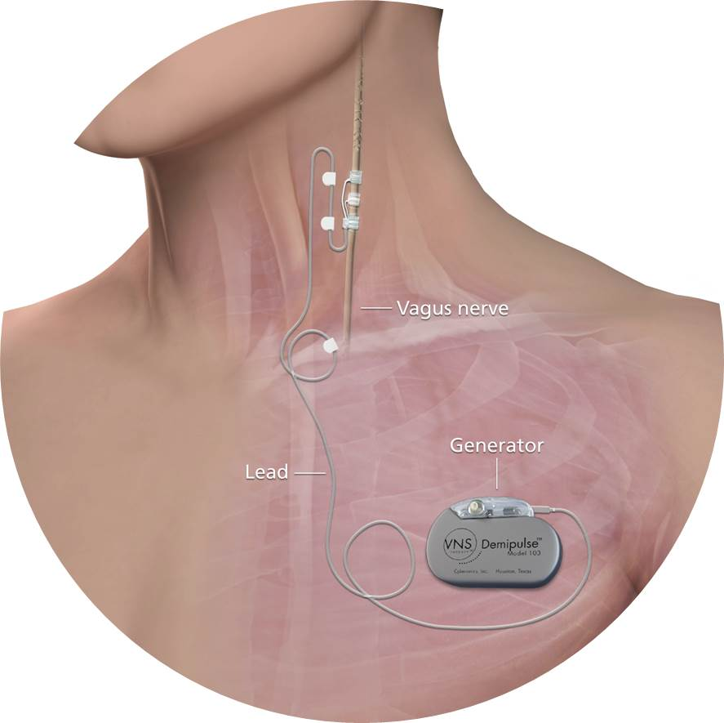
Autonomic Regulation Therapy
VNS Therapy System (Cyberonics, Houston, USA)
100,000+ left-sided implants in epilepsy patients
Implanted on L or R vagus nerve by surgeon
Without RV sensing lead
Chronic intermittent stimulation delivered to vagus
10 Hz (natural frequency), 250 µsec pulse width
VNS intensity titrated over 10 wks to max tolerable current; below the of threshold of side effects or HR change
ECG monitored continuously to confirm no acute HR change
Over time the threshold for side-effects gradually increased
Average stimulation current: 2.0 ± 0.6 mA
10 Hz, 250 µsec pulses
ON
OFF
14 sec 66 sec

Slide 11
Screening, Enrollment and Follow-up
Screening
n=78
Inc / Exc failure (n=12)
Withdrawal (n=4)
Brady arrest (n=1)
Sudden death (n=1)
Randomization
n=60
Right-Sided
Implantation
n=29
Left-Sided
Implantation
n=31
Death ¹
n=1
Titration
n=29
Titration
n=30
Death ²
n=2
3-month F/U
n=29
3-month F/U
n=28
6-month F/U
n=29
6-month F/U
n=28
Embolic stroke (implant-related)
HF death (unrelated) and sudden death (unrelated)

Slide 12
Baseline Characteristics
 | Left (n=31) | Right (n=29) | Pooled (n=60)
Age (years) | 51.2 ± 12.4 | 51.9 ± 12.4 | 51.5 ± 12.2
Male (%) | 87 | 86 | 87
Heart failure Etiology, Ischemic (%) | 68 | 83 | 75
NYHA Class II/III | 18 / 13 | 16 / 13 | 34 / 26
Body mass index (kg/m²) | 24.0 ± 3.5 | 24.2 ± 4.7 | 24.1 ± 4.1
LVEF (%) | 32.8 ± 8.0 | 31.9 ± 6.4 | 32.4 ± 7.2
LVESV (mL) | 109.1 ± 40.8 | 106.6 ± 40.1 | 107.9 ± 40.1
LVESD (mm) | 51.5 ± 7.4 | 51.6 ± 8.6 | 51.6 ± 7.9
LVEDD (mm) | 61.7 ± 6.7 | 62.2 ± 7.1 | 61.7 ± 6.7
HR (bpm) | 78 ± 11 | 77 ± 10 | 78 ± 10
Systolic blood pressure (mmHg) | 114 ± 14 | 112 ± 15 | 113 ± 15
Diastolic blood pressure (mmHg) | 73 ± 8 | 74 ± 10 | 73 ± 9
ICD implant | 0 | 0 | 0

Slide 13
Baseline Characteristics HF Drug Treatment
 | Left (n=31) | Right (n=29) | Pooled (n=60)
β-blocker (%) | 100 | 100 | 100
ACE-I or ARB (%) | 83 | 87 | 85
Aldosterone antagonist (%) | 71 | 79 | 75
Digoxin (%) | 39 | 24 | 32
Loop diuretics (%) | 97 | 79 | 88

Slide 14
Primary Safety Outcomes
 | Left | Right | Pooled
SAEs | 10 | 11 | 21
Related | 1 | 0 | 1*
Unrelated | 9 | 11 | 20†
Most Common Related Non-Serious AEs
Voice alternation, hoarseness | 11 | 8 | 19
Cough | 6 | 7 | 13
Oropharyngeal pain | 4 | 4 | 8
Implant-Related Infections | 0 | 0 | 0
System Malfunctions | 0 | 0 | 0
Therapy discontinuation by Pts or PI | 0 | 0 | 0
* Post-surgical embolic stroke
† Including 1 unrelated HF death and 1 unrelated sudden death

Slide 15
Primary Efficacy Endpoints
Mean
95% Confidence Interval
Pooled: n=57; Left: n=28; Right: n=29

Slide 16
Secondary Efficacy Endpoints
 | Baseline | 6 Months | Change | p-value
LVESD (mm) | 52 ± 8 | 49 ± 8 | -1.7 | <0.0025
NYHA Class (I/II/III/IV) | 0 / 33 / 24 / 0 | 30 / 24 / 3 / 0 |  | <0.0001
6MWD (m) | 287 ± 66 | 346 ± 78 | 56 | <0.0001
MLHFQ score | 40 ± 1 | 21 ± 10 | -18 | <0.0001
HRV (SDNN, ms) | 93 ± 43 | 111 ± 50 | 17 | <0.01
HR (bpm) | 78 ± 10 | 73 ± 11 | -3.9 | <0.005
NT-proBNP, IQR (pg/mL) | 864 [322-1788] | 888 [376-1729] | 24 | NS
CRP, IQR (pg/dL) | 1.7 [0.9-6.0] | 1.3 [0.6-2.9] | -0.4 | <0.025

Slide 17
Limitations
The study was uncontrolled and open-label; placebo effects may have contributed to the observed changes
Although no significant differences were observed in any outcome between left and right-sided ART, the confidence intervals of most measurements were wide, some differences cannot be ruled out
The study was conducted in India, and results may not generalize to other populations

Slide 18
Conclusions
The ANTHEM-HF approach to ART (chronic, low-amplitude, natural frequency), on either the left or right side, was feasible and well-tolerated
Safety assessment did not raise concerns
Both left and right-sided ART were associated with improvements in cardiac function (LVEF, LVESD, HRV) and heart failure symptoms (NYHA class, 6-minute walk distance, quality of life)
Further investigation of ART in a controlled clinical study is warranted

Slide 19
on line publication available in Journal of Cardiac Failure at:
DOI: http://dx.doi.org/10.1016/j.cardfail.2014.08.009

